Slide 1
Question Answering
Complex Questions: Summarizing Multiple Documents

Slide 2
Definition questions
Q: What is water spinach?
A: Water spinach (ipomoea aquatica) is a semi-aquatic leafy green plant with long hollow stems and spear- or heart-shaped leaves, widely grown throughout Asia as a leaf vegetable. The leaves and stems are often eaten stir-fried flavored with salt or in soups. Other common names include morning glory vegetable, kangkong (Malay), rau muong (Viet.), ong choi (Cant.), and kong xin cai (Mand.). It is not related to spinach, but is closely related to sweet potato and convolvulus.

Slide 3
Medical questions
Demner-Fushman and Lin (2007)
Q: In children with an acute febrile illness, what is the efficacy of single medication therapy with acetaminophen or ibuprofen in reducing fever?
A: Ibuprofen provided greater temperature decrement and longer duration of antipyresis than acetaminophen when the two drugs were administered in approximately equal doses. (PubMedID: 1621668, Evidence Strength: A)

Slide 4
Other complex questions
Modified from the DUC 2005 competition (Hoa Trang Dang 2005)
How is compost made and used for gardening (including different types of compost, their uses, origins and beneﬁts)?
What causes train wrecks and what can be done to prevent them?
Where have poachers endangered wildlife, what wildlife has been endangered and what steps have been taken to prevent poaching?
What has been the human toll in death or injury of tropical storms in recent years?

Slide 5
Answering harder questions: Query-focused multi-document summarization
The (bottom-up) snippet method
Find a set of relevant documents
Extract informative sentences from the documents
Order and modify the sentences into an answer
The (top-down) information extraction method
build specific answerers for different question types:
definition questions
biography questions
certain medical questions

Slide 6
Query-Focused Multi-Document Summarization
a

Slide 7
Simplifying sentences
Zajic et al. (2007), Conroy et al. (2006), Vanderwende et al. (2007)
Simplest method: parse sentences, use rules to decide which modifiers to prune
(more recently a wide variety of machine-learning methods)
appositives | Rajam, 28, an artist who was living at the time in Philadelphia, found the inspiration in the back of city magazines.
attribution clauses | Rebels agreed to talks with government officials, international observers said Tuesday.
PPs without named entities | The commercial fishing restrictions in Washington will not be lifted unless the salmon population increases [PP to a sustainable number]]
initial adverbials | “For example”, “On the other hand”, “As a matter of fact”, “At this point”

Slide 8
Maximal Marginal Relevance (MMR)
Jaime Carbonell and Jade Goldstein, The Use of MMR, Diversity-based Reranking for Reordering Documents and Producing Summaries, SIGIR-98
An iterative method for content selection from multiple documents
Iteratively (greedily) choose the best sentence to insert in the summary/answer so far:
Relevant: Maximally relevant to the user’s query
high cosine similarity to the query
Novel: Minimally redundant with the summary/answer so far
low cosine similarity to the summary
Stop when desired length

Slide 9
LLR+MMR: Choosing informative yet non-redundant sentences
One of many ways to combine the intuitions of LLR and MMR:
Score each sentence based on LLR (including query words)
Include the sentence with highest score in the summary.
Iteratively add into the summary high-scoring sentences that are not redundant with summary so far.

Slide 10
Information Ordering
Chronological ordering:
Order sentences by the date of the document (for summarizing news)..
(Barzilay, Elhadad, and McKeown 2002)
Coherence:
Choose orderings that make neighboring sentences similar (by cosine).
Choose orderings in which neighboring sentences discuss the same entity (Barzilay and Lapata 2007)
Topical ordering
Learn the ordering of topics in the source documents

Slide 11
Domain-specific answering: The Information Extraction method
a good biography of a person contains:
a person’s birth/death, fame factor, education, nationality and so on
a good definition contains:
genus or hypernym
The Hajj is a type of ritual
a medical answer about a drug’s use contains:
the problem (the medical condition),
the intervention (the drug or procedure), and
the outcome (the result of the study).

Slide 12
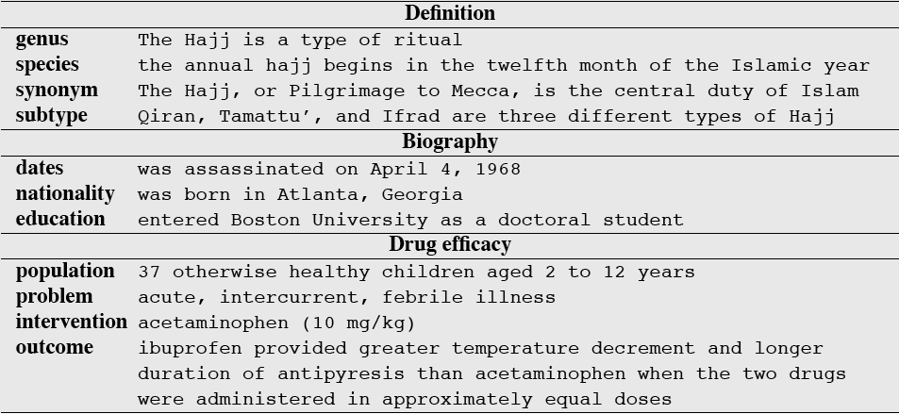
Information that should be in the answer for 3 kinds of questions

Slide 13
Architecture for complex question answering: definition questions
S. Blair-Goldensohn, K. McKeown and A. Schlaikjer. 2004. Answering Definition Questions: A Hybrid Approach.

Slide 14
Question Answering
Answering Questions by Summarizing Multiple Documents

